Slide 1
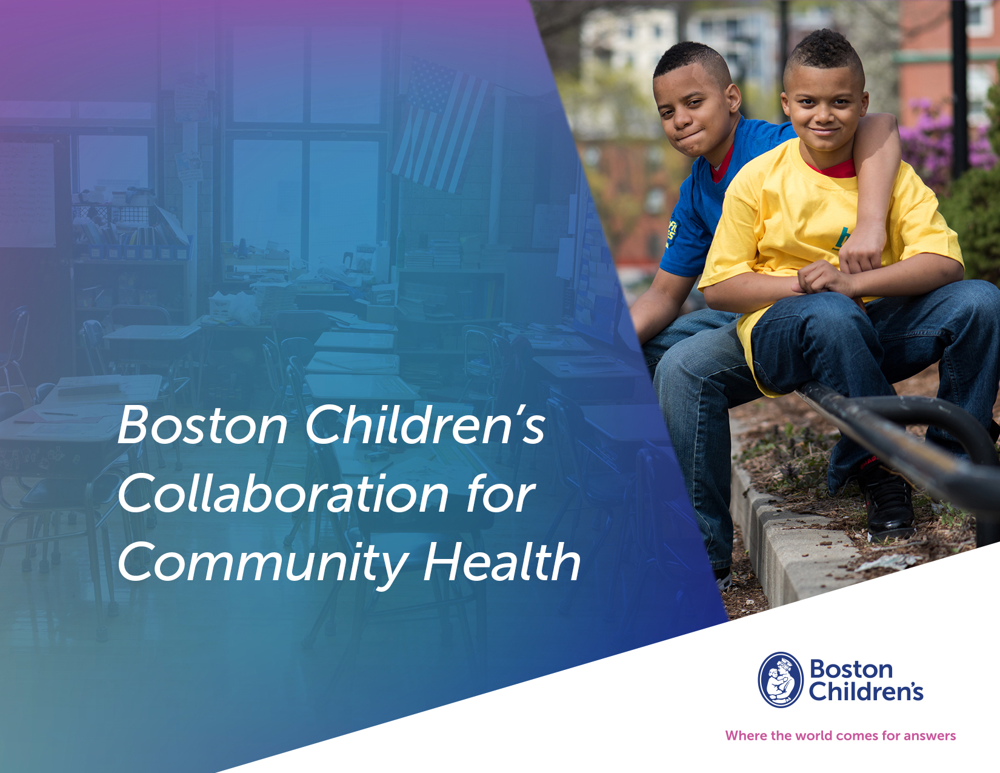
Highlights from the 2023 Report
Debbie Lay, MPH, MA
Senior Manager of
Community Health Initiatives
Notes:
Thank you for tuning in to this prerecorded webinar.
my name is debbie lay and I’m a senior manager in boston children’s hospital’s office of community health.
I’ll be sharing some highlights from our Boston Children’s collaboration for community health 2023 report

Slide 2

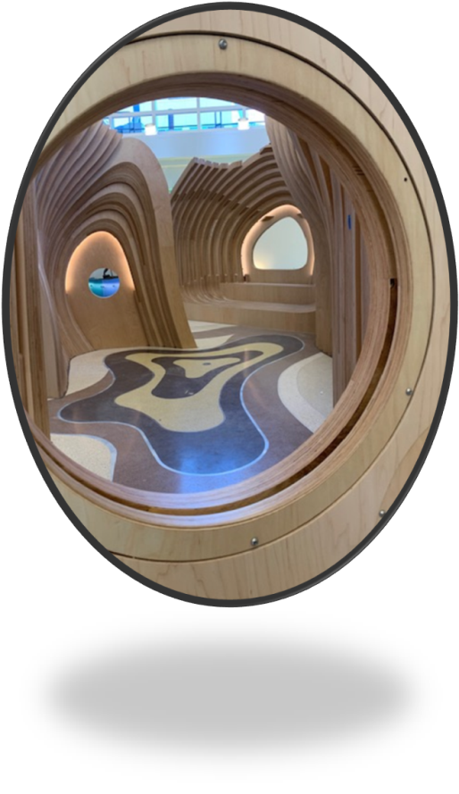
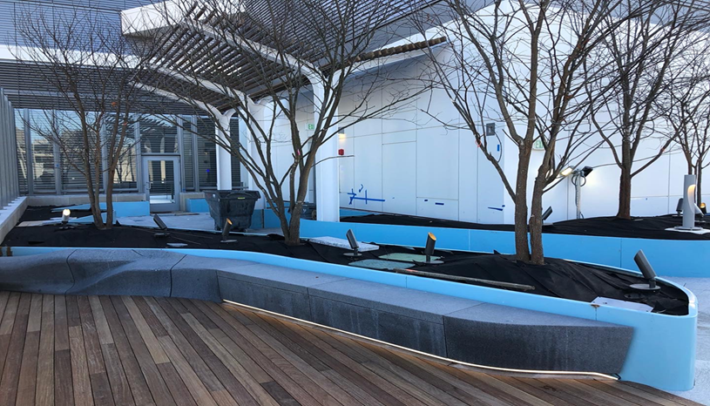
Collaboration for Community Health
Part of Boston Children’s clinical expansion
Department of Public Health regulations: 5% of capital cost to community health initiative
$53.4 million over 7 – 10 years, directed to community organizations, agencies, coalitions
Social determinants of health, not health services
Notes:
the collaboration for community health (or the collaboration as I’ll refer to it) is tied to the hospital’s clinical expansion plans, which are regulated by the state department of public health. This regulation is called a determination of need community health initiative, and the regulation requires that 5% of the capital cost to go towards community health initiatives that focus on social determinants of health, not health services. For this particular clinical expansion which was tied to the Hale Building on the Longwood campus, 5% of the capital cost equates to $53.4 M to be distributed over 7-10 years to community organizations, agencies, and coalitions.
Boston children’s office of community health oversees the distribution of the $53.4 million and works with a consultant to evaluate the progress of funded partners over time.

Slide 3






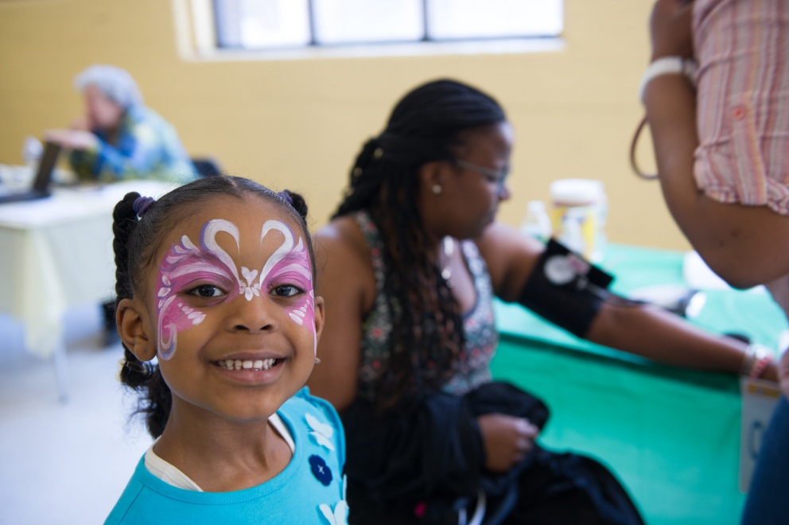









Collaboration for Community Health
$2.4M: Special Initiatives
$17M: Birth to 5
Child Health & Development
$3.5M: Evaluation and Data
$7M: Mental Health &
Healthy Youth Development
$5M: Family Housing Stability
$1M: Family Economic Opportunity
$3M: Community Trauma Response
$10M: Community Health Equity Collaborative
$4.5M: Healthy Living
Improve the health and well-being of children and families in communities disproportionately impacted by systemic injustices and inequities in health and social determinants of health.
Notes:
The $53.4M is broken into the different initiatives you see here.
These initiatives were identified through a 1.5 year long community engagement process that included community conversations and convening of an advisory committee to develop a strategic funding plan. The initiative areas represent the impact of family, community, and systems on children’s health.
The overall goal of the collaboration is at the bottom: to improve the health and wellbeing of children and families in communities disproportionately impacted by systemic injustices and inequities in health and social determinants of health, primarily Children and families of color, including those of immigrant or low-income backgrounds

Slide 4
Collaboration for Community Health
Special initiatives: 9 Partners
Birth to 5 Child Health & Development: 27 Partners*
$3.5M: Evaluation and Data
Mental Health &
Healthy Youth Development: 37 Partners
Family Housing Stability:
10 Partners
Family Economic Opportunity:
6 Partners
Community Trauma Response:
4 Partners
Community Health Equity Collaborative:
4+ Partners
Healthy Living: 22 Partners
Improve the health and well-being of children and families in communities disproportionately impacted by systemic injustices and inequities in health and social determinants of health.
Notes:
Through that Request for proposals and review process, we ended up with the number of funded partners you see here in each initiative. These numbers include partners from our first round of three-year funding, which started in 2018, as well as our second round of three-year funding which started in 2021. For today’s presentation and the 2023 report, we will primarily be focusing on partners that have projects that started in 2021 or after.

Slide 5
Highlights from the 2023 Report
Notes:
The report is posted on our website, so I encourage you to visit our community health page for the full document. But for now I will share a few highlights from the report which covers progress from 2021 to late 2023.

Slide 6
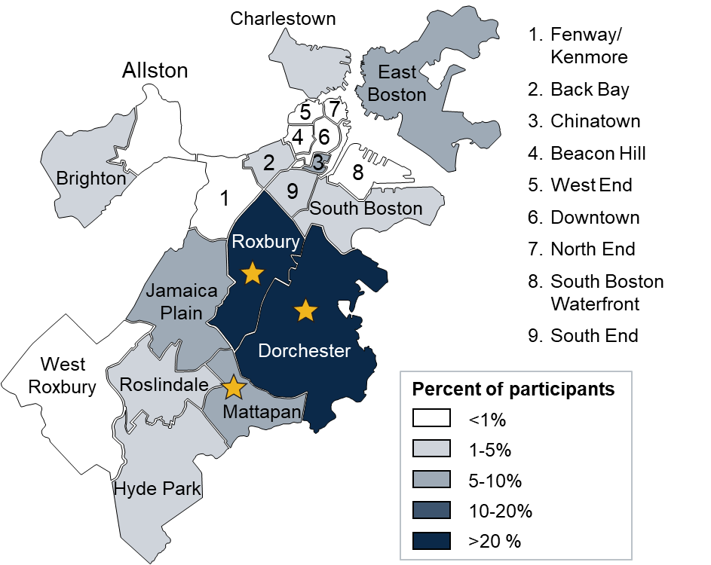
Reach by Neighborhood
Key communities served include Boston neighborhoods with the highest childhood poverty rates
Includes participants with Boston zip codes only.
Indicates Boston neighborhoods with largest concentration of children in poverty. Source: The Boston Indicators Project.
Notes:
Funded partners primarily reached Boston residents in Dorchester, Roxbury, and Mattapan. The stars here indicate Boston neighborhoods with the largest concentration of children in poverty, and you can see that we have reached many of those key neighborhoods.

Slide 7
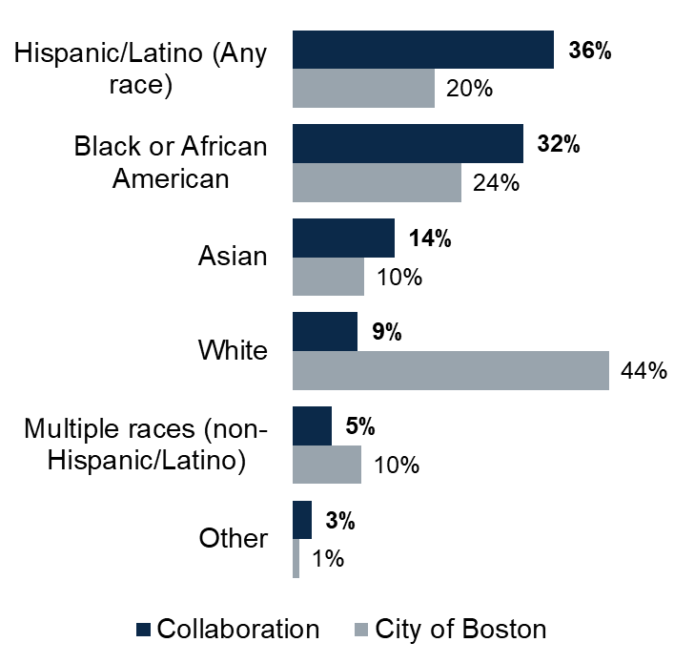
Reach by Race and Ethnicity
Two-thirds of individuals reached by the Collaboration are Black or Hispanic/Latino, compared to 44% of Boston residents
Notes:
Our funded partners are reaching racial and ethnic populations that have been historically marginalized. 68% or just over two thirds of program participants identify as Black or Hispanic/Latino, compared to the city of Boston where 44% of residents identify as Black or Hispanic/Latino.

Slide 8
Reach by Participant Type
The Collaboration primarily engaged young children, parents, and young adults in health-promoting programs
Notes:
In terms of the ages or types of individuals reached, Funded partners primarily engaged with young children, parents, and young adults which aligns with our focus on children, youth and families.

Slide 9
Birth to Five Child Health & Development
15 funded partners
Build early childhood providers’ capacity to address social determinants of health and social, emotional, and behavioral health
Develop parent and provider capacity to advocate for increased investments in early childhood and family-centered programs and services
Connect families with free culturally and linguistically appropriate community resources
Sept 2021 – Aug 2023 Highlights
>11,000 community members engaged
322 early educators trained in best practices
5,318 children screened for developmental concerns
115 children demonstrated new skills in domains of kindergarten readiness
718 caregivers reported increased self-efficacy, knowledge, confidence, and/or awareness of resources
Notes:
The hospital has 8 initiatives, of which 7 will be highlighted today.
The first is our birth to 5 initiative, where our 15 funded partners are working to Build early childhood provider capacity, Develop parent and provider capacity to advocate for themselves and for additional services, and Connect families with free culturally and linguistically appropriate resources
Since 2021, they have engaged over 11,000 community members, trained 322 early educators on best practices, and screened 5,318 children for developmental concerns. Their efforts have resulted in 115 children demonstrating increased kindergarten readiness, and 718 caregivers feeling increased confidence and knowledge of resources.

Slide 10
Healthy Living
12 funded partners
Engage children and families in physical activity
Engage youth in urban farming, provide nutrition education, and support local food systems
Educate caregivers about healthy eating and active lifestyles
Engage youth as leaders within programs
Distribute free meals and produce to families
Sept 2021 – Aug 2023 Highlights
>2,250 community members engaged
345 sessions of healthy eating and farming education
50,868 servings of produce distributed and purchased
94 youth increased their knowledge of health, nutrition, and social determinants of health through trainings
278 parents adopted healthy behaviors after participating in healthy living conversations
Notes:
In our healthy living initiative, our 12 funded partners are working to engage residents in physical activity and nutrition education, engage youth leaders in programs, and distribute healthy food to families.
Since 2021, they have engaged over 2,250 residents in urban farming and nutrition education, held 345 sessions of healthy eating and farming education, and distributed over 50,000 servings of produce. Their efforts have resulted in 94 youth reporting increased knowledge of health, nutrition, and social determinants of health, and 278 parents adopting healthy behaviors.

Slide 11
Family Housing Stability
& Economic Opportunity
6 funded partners
Engage residents in advocacy efforts to improve availability of affordable housing and protect tenants’ rights
Build strategic partnerships to improve policymaker knowledge of tenant-driven housing policy
Provide individual counseling, rental assistance, and/or financial savings programs
Sept 2021 – Aug 2023 Highlights
Nearly 3,000 residents engaged
51 meetings with policymakers to discuss affordable homeownership policies
1,810 households participated in housing and/or economic support services
$630 million secured for new affordable homeownership units
434 families stably housed
Notes:
In our family housing stability and economic opportunity initiatives, our 6 funded partners are working to engage residents in advocacy efforts, build strategic partnerships to drive policy change, and offer individual financial or housing support for residents.
Since 2021, they have nearly 3,000 residents, held 51 meetings with policy makers, and provided 1,810 households with housing or economic support services. Through their efforts, they secured $630 M for new affordable homeownership units, and helped 434 families secure stable housing

Slide 12
Mental Health Systems
6 funded partners
Supporting racial/ethnic and linguistically diverse students to enter the mental health provider workforce
Providing accessible educational opportunities for clinical graduate students, mental health providers, and community members to deliver trauma-informed support
May 2022 – August 2023 Highlights
152 providers, young adults, and adults engaged
110 students and professionals enrolled in training programs
303 clinical students and community members received training in culturally responsive care
Students enrolled in training programs shared that mentors supported their well-being by offering strategies and resources
Practitioners receiving culturally aligned supervision reported feeling supported to process their clinical experiences
Notes:
In our mental health systems initiative, our 6 funded partners are supporting students from underrepresented populations to enter the mental and behavioral health provider workforce, and providing accessible educational opportunities for students and existing providers.
Since 2022, they have engaged 152 mental health providers, young adults and adults and enrolled 110 students and professionals across their training programs. Through their efforts, students have shared that mentors have supported their well-being and connected them with resources and strategies. existing practitioners were able to receive culturally aligned supervision that allowed them to feel supported and process their clinical experiences.

Slide 13
Healthy Youth Development
20 funded partners
Develop or expand programming that supports youth college readiness and employment
Promote youth leadership and development
Connect youth with resources for their physical and mental health
May 2022 – August 2023 Highlights
>3,000 youth, families, and staff engaged
1,654 sessions offered related to mentoring, mental health, career and/or education
85 referrals for youth to additional programs and services
292 youth increased social-emotional competencies
34 youth improved their wages or employment status
Notes:
In our youth support systems initiative, our 20 funded partners are delivering programming around college readiness and employment, promoting youth leadership and development, and connecting youth with resources.
Since 2022, they have engaged over 3000 youth, offered over 1600 sessions on a variety of topics, and made 85 referrals for youth to additional programs and services. Through their efforts, 292 youth reported increased social emotional competencies, and 34 improved their wages or employment status

Slide 14
Children’s Health Equity
4 funded collaboratives
Develop resident leadership and expand communities’ power to address the social determinants of child health
Increase coordination among service providers and address service gaps
Address disparities in neighborhoods and schools through targeted expansion of supports and services
Jan 2021– June 2023 Highlights
>2,500 community members engaged
869 referrals facilitated access to community programs for youth and parents
99 youth and residents taking on leadership roles
344 caregivers engaged in shaping their children’s education
84 youth reported greater access and awareness of youth programming & services
Notes:
In our children’s health equity initiative, our four neighborhood-based collaboratives are working across sectors to develop resident leadership and expand community power, increase service coordination, and address greater disparities to create durable change in their communities.
Since 2021, they have engaged over 2500 community members, facilitated 869 referrals, and recruited 99 youth and residents to take on leadership roles. Through their efforts, 344 caregivers became engaged in shaping and advocating for their children’s education, and 84 youth reported greater access and awareness of local resources.

Slide 15
See the 2023 Report: www.childrenshospital.org/community-health/collaboration-community-health
Questions?
Debbie.lay@childrens.Harvard.edu
Notes:
There is much more in the report itself, including quotes and specific accomplishments from some of our funded partners. Visit the Collaboration for Community Health’s website to read more.
And if you have further questions, please email me at debbie.lay@childrens.Harvard.edu.

Slide 16

Acknowledgements
Boston Children’s Hospital
Tara Agrawal, PhD, MS
Shari Nethersole, MD
Stacy Walker, MBA
Marisa Otis, MPH
Haley Piette, MPH, CHES
Jennifer Fine, MPA
Jessica Clement
Mathematica
Drew Koleros, MPH
Dayna Gallagher
Naomi Ali, MPH, MS
Faye Miller
A’lantra Wright, MPH, CAPM
Notes:
Thank you to my colleagues in the office of community health who help oversee the work within each of our initiatives, to our evaluation partner Mathematica who developed this report, and to all of our collaboration for community health funded partners of which there are too many to list here for their partnership and commitment to serving children and families in Boston.

